Slide 1

Namespaces

Slide 2
Namespaces
Global identifiers in a header file used in a program become global in the program
A syntax error occurs if a program’s identifier has the same name as a global identifier in the header file
The same problem can occur with third-party libraries
Common solution: third-party vendors begin their global identifiers with _ (underscore)
Do not begin identifiers in your program with _

Slide 3
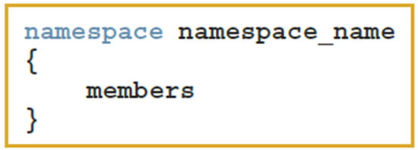
Namespaces
ANSI/ISO Standard C++ attempts to solve this problem with the namespace mechanism (most recent compilers)
The general syntax of the statement namespace is:
where members consist of variable declarations, named constants, functions, or another namespace

Slide 4
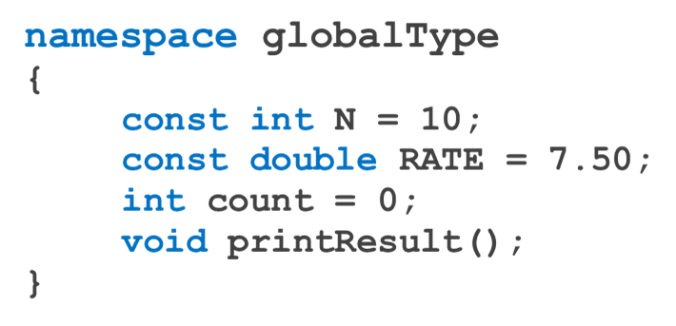
Namespaces
EXAMPLE 7-8
defines globalType to be a namespace with four members: named constants N and RATE, the variable count, and the function printResult.

Slide 5



Namespaces
A namespace member has scope local to the namespace
A namespace member can be accessed outside the namespace
The general syntax for accessing a namespace member is:
ANSI/ISO Standard C++ provides the use of the statement using

Slide 6
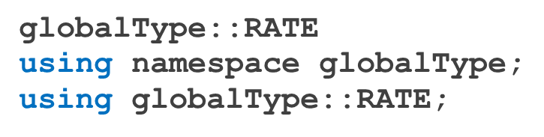
Namespaces
Examples with namespaces
After the using statement, it is not necessary to put the
Unless a namespace member and a global identifier or a block identifier have the same name
https://replit.com/@btaylan/CISC3142Codes#Lecture-6/1.cpp
https://replit.com/@btaylan/CISC3142Codes#Lecture-6/2.cpp
https://replit.com/@btaylan/CISC3142Codes#Lecture-6/3.cpp
https://replit.com/@btaylan/CISC3142Codes#Lecture-6/4.cpp
https://replit.com/@btaylan/CISC3142Codes#Lecture-6/5.cpp

Slide 7
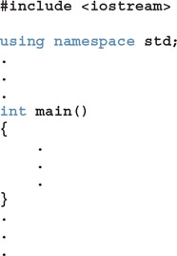
Namespaces
The header file iostream contains the global identifiers such as cin, cout, and endl, pow() method, etc.
Without using the prefix std:: before the identifier name:
https://replit.com/@btaylan/CISC3142Codes#Lecture-6/6.cpp
The obvious restriction is that the block (or function) that refers to the global identifier (of the header file iostream) must not contain any identifier with the same name as this global identifier.
https://replit.com/@btaylan/CISC3142Codes#Lecture-6/7.cpp
https://replit.com/@btaylan/CISC3142Codes#Lecture-6/8.cpp

Slide 8
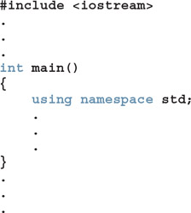
Namespaces
The using statement appears inside the function main.
Other functions cannot access namespace and should use the prefix std:: before the name of the global identifier of the header file iostream unless the function has a similar using statement.

Slide 9
string Type
To use data type string, a program must include the header file string
A string is a sequence of zero or more characters
The first character is in position 0
The second character is in position 1, etc.
Binary operator + performs the string concatenation operation
Array subscript operator [] allows access to an individual character in a string
https://replit.com/@btaylan/CISC3142Codes#Lecture-6/9.cpp

Slide 10
string Methods
strVar.at(index) Returns the element at the position specified by index.
strVar.append(n, ch) Appends n copies of ch to strVar, where ch is a char variable
or a char constant.
strVar.append(str) Appends str to strVar.
strVar.clear() Deletes all the characters in strVar.
https://replit.com/@btaylan/CISC3142Codes#Lecture-6/10.cpp

Slide 11
string Methods
strVar.compare(str) Returns ascii difference of strings
strVar.empty() Returns 1 if strVar is empty; otherwise it returns 0 .
strVar.erase() Deletes all the characters in strVar.
strVar.erase(pos, n) Deletes n characters from strVar starting at position pos.
https://replit.com/@btaylan/CISC3142Codes#Lecture-6/12.cpp

Slide 12
string Methods
strVar.find(str) Returns the index of the first occurrence of str in strVar.
strVar.find(str, pos); Returns the index of the first occurrence at or after pos
strVar.find_first_of(str, pos) Returns the index of the first common character after pos in strVar
strVar.find_first_not_of(str, pos) Returns the index of the first occurrence of any uncommon character of in strVar after pos
https://replit.com/@btaylan/CISC3142Codes#Lecture-6/13.cpp

Slide 13
string Methods
strVar.insert(pos, n, ch); Inserts n occurrences of the character ch at index pos into strVar
strVar.insert(pos, str); Inserts all the characters of str at index pos into strVar.
strVar.length() Returns the number of characters in strVar.
strVar.replace(pos, n, str); Starting at index pos, replaces the next n characters of strVar.
strVar.substr(pos, len) Returns a string which is a substring of strVar starting at pos.
strVar.size() Returns giving the number of characters in strVar. Alias of lenghtO
strVar.swap(str1); Swaps the contents of strVar and str1. str1 is a string variable.
https://replit.com/@btaylan/CISC3142Codes#Lecture-6/14.cpp

Slide 14
Arrays and Strings

Slide 15

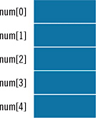
Declaring an Array
Array: a collection of a fixed number of components, all of the same data type
Example:
int num[5];
intExp: a positive integer

Slide 16
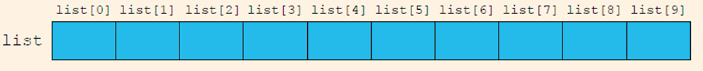
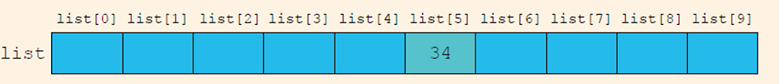
Accessing Array Components
This statement declares an array of 10 components:
int list[10];
list[5] = 34;

Slide 17
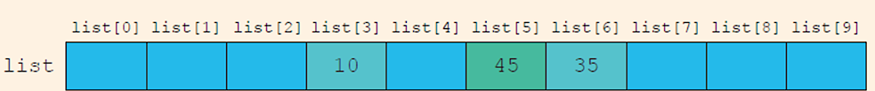
Accessing Array Components
list[3] = 10;
list[6] = 35;
list[5] = list[3] + list[6];
https://replit.com/@btaylan/CISC3142Codes#Lecture-6/15.cpp

Slide 18
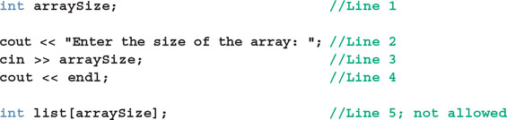
Warning!
When you declare an array, its size must be specified. For example, you cannot do the following in standard C++ before C++11. :
When the compiler compiles Line 5, the size of the array is unknown and the compiler will not know how much memory space to allocate for the array
Dynamic arrays are required.

Slide 19
Processing One-Dimensional Arrays
Use a for loop to access array elements:
cout << "Enter 5 values" <<endl;
for(int i=0;i<SIZE;i++)
cin>> num[i];
https://replit.com/@btaylan/CISC3142Codes#Lecture-6/16.cpp

Slide 20
Array Index Out of Bounds
The index of an array is between 0 and ARRAY_SIZE - 1
Otherwise, the index is out of bounds
In C++, there is no guard against indices that are out of bounds
This check is solely the programmer’s responsibility
https://replit.com/@btaylan/CISC3142Codes#Lecture-6/17.cpp

Slide 21
Array Initialization During Declaration
Arrays can be initialized during declaration
Values are placed between curly braces
double sales[5] = {12.25, 32.50, 16.90, 23, 45.68}
Example 2: the array size is determined by the number of initial values in the braces if the array is declared without size specified
double sales[] = {12.25, 32.50, 16.90, 23, 45.68}

Slide 22
Partial Initialization of Arrays During Declaration
int list[10] = {0};
Declares an array of 10 components and initializes all of them to zero
int list[10] = {8, 5, 12};
Declares an array of 10 components and initializes list[0]= 8, list[1] =5, list[2]=12
All other components are initialized to 0
Cannot skip indexes. The fourth element is uninitialized, all elements that follow the fourth element must be left uninitialized.

Slide 23
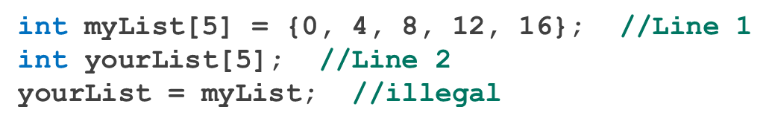
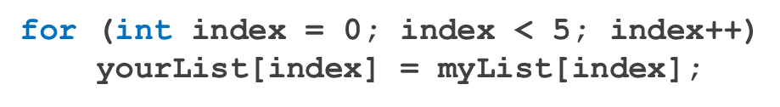
Some Restrictions on Array Processing
Erroneous array copy
Solution
Similarly, determining whether two arrays have the same elements and printing the contents of an array must be done component-wise.

Slide 24
Arrays as Parameters to Functions
Arrays are passed by reference only
Do not use symbol & when declaring an array as a formal parameter
The size of the array is usually omitted in the array parameter
If provided, it is ignored by the compiler

Slide 25
Constant Arrays as Formal Parameters
Since arrays are passed by refences, if function changes the array and the change will be visible outside of the function as well
To prevent a function from changing the array
Use const in the declaration of the formal parameter
Example
https://replit.com/@btaylan/CISC3142Codes#Lecture-6/18.cpp

Slide 26
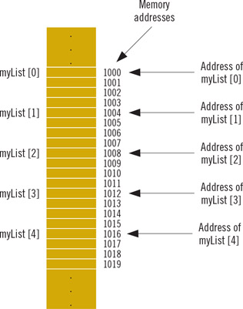
Base Address of an Array and Array in Computer Memory
The base address of an array is the address (memory location) of the first array component
The base address of list is list[0]
When an array is passed as a parameter, the base address of the actual array is passed to the formal parameter

